Slide 1

Puberty
Year 7 Health – 2024
Lesson 4

Slide 2

Today’s focus
Define puberty .
Understand the purpose of puberty.
Identify social, emotional, and physical changes that occur to males and females.

Slide 3

(pg.35)
In the first 5 minutes of each lesson, you will complete your revision page, you will find these throughout your booklet.
The revision page consists of three questions. It will need to be completed in detail. One-word answers will not be accepted.
The three questions :
What two concepts or ideas did I learn in class last week?
What did I find interesting about last week’s lesson? Provide a specific example.
Any questions or new words you have learnt?
The teacher will go over this each lesson with you to see what you have learnt. It is a great way for you to revisit content and test your memory.

Slide 4

Expectations
Puberty is a time that every single person will go through at some stage.
EVERYONE is different and has their own experiences with puberty.
We need to be respectful of everyone’s thoughts/feelings/experiences of this time.
Approach the topic with a level of maturity.
Get used to saying the proper terminology.

Slide 5


Question Box
If you have a question that you want to ask but you don’t want to ask it out loud… write it on a piece of paper and place it in the question box.
In some lessons we will read out questions that are in the box and your teacher will answer them.
You do not need to write your name – you can remain anonymous if you like!
If you would like to have a chat with your teacher, write your name on your question paper and they can speak with you personally, or just ask to have a chat!

Slide 6
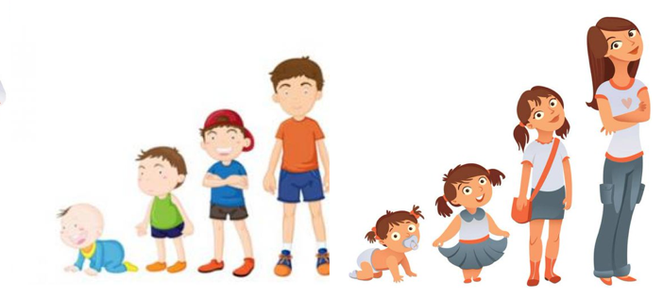
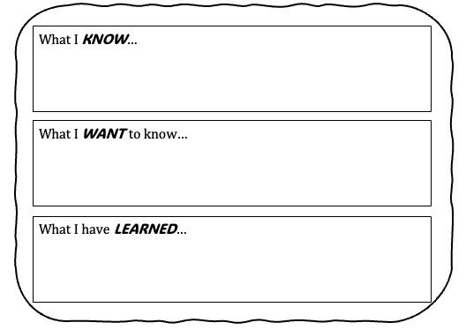
Activity 1: Puberty KWL (pg.36)
Complete the first two boxes of the KWL:
What do you already know about puberty?
What do you want to know about puberty?
Leave the last box empty because we will revisit this at the end of the term to complete it.
You have 4 minutes.

Slide 7
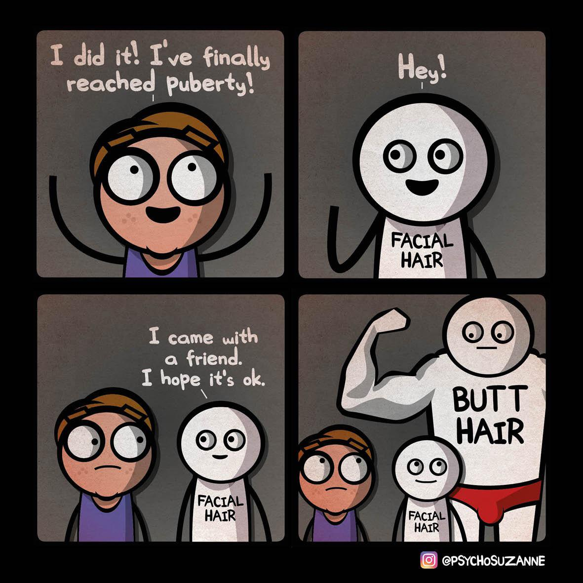
Hook #1: What words do you know?
All students stand around the room in a circle.
The only person who is allowed to talk is the person with the ball.
Once you have answered the question, you throw the ball to someone new.
Q: What words come to mind when you hear PUBERTY?
You cannot:
Call out without the ball.
Use any swear words or say more than one word at a time.
Shout out loud.
Ideas: changes that happen to the body, reasons for puberty, feelings that you may feel during puberty, activities you start to do as you get older, words related to relationships etc.
Notes:
Two options for a hook activity – this is option 1.
Choose what option you would prefer and what would best suit your class.
Resources – stress ball (something to throw and catch around the room)
The idea behind this game is to break the ice around the topic of puberty. This is an opportunity for students to use slang terminology and funny words before they are expected to use proper terms moving forward. If students are struggling to think of a word or they feel uncomfortable, encourage them to think of other words associated with the ‘ideas’ at the bottom of the slide.
After this activity, emphasise that students are expected to use correct terminology moving forward (i.e., penis instead of willy etc.).
For example:
- period (a change that occurs during puberty)
- willy (a slang term for penis)
- confused (an emotion that may be felt during puberty)
- boyfriend/girlfriend (a relationship that may start to develop during pubescent years)
- hormones (the thing that triggers puberty in our body)
- movies (something we do with our friends as we get older)

Slide 8

Hook #2: Brain Dump (pg.37)
Write down at least 10 ideas that come to mind relating to things you already know about Puberty.
You have 3 minutes.
Notes:
Two options for a hook activity – this is option 2, part 1.
Choose what option you would prefer and what would best suit your class.
Students can write their answers in their workbook.

Slide 9
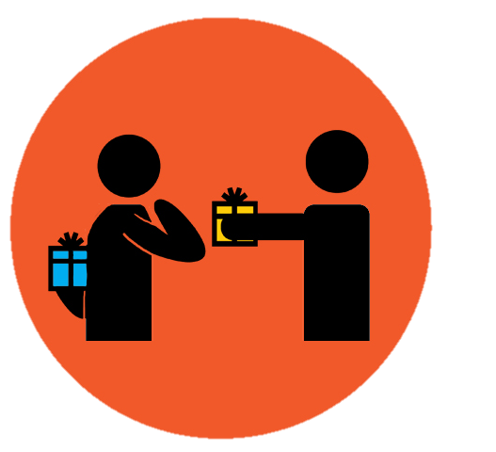
Hook #2: Give one, get one (pg.37)
Now you have your brainstorm of 10 ideas move around the classroom and talk to others. Give them one of your answers and get one of theirs in return.
Sit down again when you have added 10 new puberty ideas to your list (or have 20 in total).
You have 3 minutes.
Notes:
Two options for a hook activity – this is option 2, part 2 → This is OPTIONAL.
Choose what option you would prefer and what would best suit your class.
Students can write their answers in their workbook.

Slide 10

Why do we need to learn about this stuff? (pg.37)
When we talk about the changes that occur during puberty, we will talk about them in relation to people born with a male reproductive system (male) and people born with a female reproductive system (female).
It is important for us to learn about puberty because these are changes and experiences that are going to directly affect you and impact your life. It is also going to happen to every single person – your parents and grandparents experienced it, your friends will go through it, and eventually all the babies in the world will go through it too (even pet dogs!).
It is important to learn about it so you can prepare for the changes that are going to occur and you can understand why they are happening. It is also beneficial for females to learn about the male changes, and males to learn about the female changes, because you will have these people in your life – whether they be friends, family, coworkers, teammates or even lovers. If you know and understand what is happening, then you can help each other through the rollercoaster ride that is puberty.
Notes:
Also in their books.

Slide 11

GLOSSARY: (Pg. 5)
At the front of your books is your glossary. Turn to your glossary and add the following words and their definitions:
Puberty
The period during which adolescents reach sexual maturity and become capable of reproduction.
Adolescence
The period where a young person develops from a child into an adult.
Reproduction
The production of offspring (children) which occurs through sexual intercourse.
Notes:
Relevant to test

Slide 12

Puberty: (pg.38)
The changes that occur during puberty can be categorised as:
PHYSICAL
SOCIAL
EMOTIONAL
The purpose of puberty is to allow the body to mature into an adult and become capable of sexual reproduction.
The trigger for puberty is the production of ‘gonadotrophin releasing hormone’ (GnRH) from a part of the brain called the hypothalamus.
This hormone (GnRH) stimulates the pituitary gland to send a signal to the ovaries in a girl, and the testes in a boy, to release their sex hormones.
Notes:
RELEVANT TO TEST (purpose of puberty)
Video is optional but accompanies the extra information on the slide.
1.38mins - https://www.youtube.com/watch?v=Y-m4ppqMLPc

Slide 13
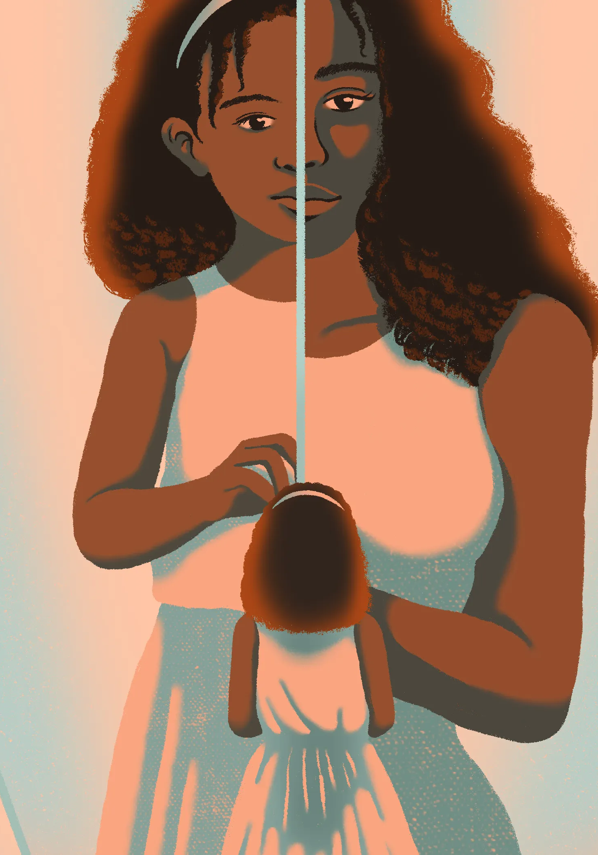
Activity 1: (pg.38)
In the space provided in your books answer the questions below:
What is puberty?
What is the purpose of puberty?
What causes puberty to happen?
How do you feel about puberty?
Make sure you write your answers in your own words.
Once finished, discuss your answers with your partner.
Be prepared to share your answers with the class.
You have 6 minutes.
Notes:
RELEVANT TO TEST

Slide 14
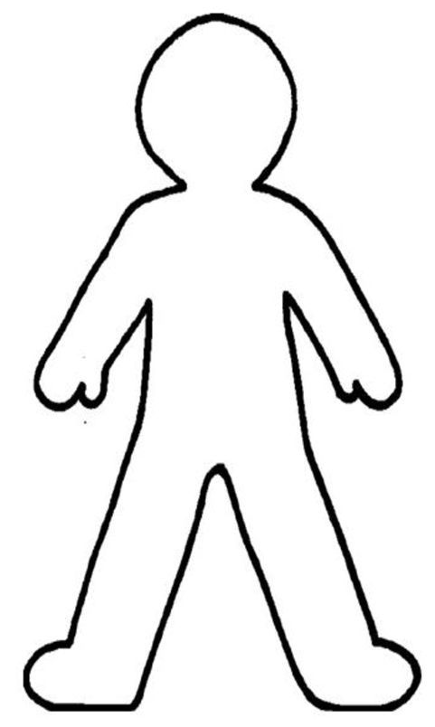
Activity 2: Puberty Changes (pg.39)
Mood swings
Breasts develop
Watch the videos over the next slides about puberty changes in boys and girls.
Choose 3 different colours - one for boys, one for girls and one for both.
While watching ‘Puberty for Boys,’ label the changes that occur and draw a line to show where on the body that change occurs.
Repeat for ‘Puberty for Girls.’
Using your third colour, highlight/underline/draw a circle around the changes that occur to BOTH males and females during puberty.
Erections become possible
Notes:
RELEVANT TO TEST
ALTERNATIVE:
- all students can complete this as a hard copy.
- students can complete this in groups or individually on A4, A3 or butcher’s paper and they can draw their own person.
- If students are unable to draw lines or change font colours, they can simply list the changes in the respective boxes on their page.
- if students are completing this as a hard copy or can draw lines and change font colours, then they can complete the activity as outlined in their books and on the slide.
Example provided:
- Purple = girls changes
- Red = boys changes
- Yellow = occurs to both

Slide 15

Notes:
5mins
Allow 2 mins after the video to add to their work.

Slide 16

Notes:
4.29mins
Allow 2 mins after the video to add to their work.

Slide 17
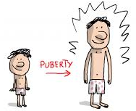
Activity 3: Physical, Social and Emotional Changes (pg.40)
Now you have learnt about some of the physical changes that occur during puberty, but what about the social and emotional ones that may happen?
Social changes are those changes that may happen around our relationships with our friends, family, lovers etc. Emotional changes are those changes that involve our feelings – how we feel about ourselves and others.
Complete the table in your books by researching the answers – physical changes for girls and boys, social and emotional changes for both.
A minimum of 7x changes that occur during puberty in each column.
You can use the changes you wrote down from your previous activity, but you are still expected to find extras.
You may work in pairs.
Some websites are given to you in your books to help you.
You have 15 minutes.
Notes:
RELEVANT TO TEST
Some websites are listed in their books as links for them to click on. They are also listed below:
Better Health Channel - Puberty
Kids Health.org - Puberty Basics
Health Direct - Puberty for Girls
Health Direct - Puberty for Boys
Answers on next slide.

Slide 18
PHYSICAL CHANGES MALE | PHYSICAL CHANGES FEMALE | SOCIAL/EMOTIONAL CHANGES
Growth spurt Testicle growth Penis growth Facial and body hair Voice deepens Pubic hair Adam’s apple develops Increased muscle mass Acne Sweat glands develop Sperm production Shoulders broaden | Menstruation/period Breast development Growth spurt Hips widen Pubic hair Vaginal changes (growth and discharge) Acne Sweat glands develop | Mood swings Development of relationships with friends Desire to challenge authority/rebel Confidence/self-esteem may decrease Body image concerns Want more independence Become interested in romantic relationships Social comparison Develop identity Develop social skills Explore sexual orientation
Notes:
RELEVANT TO TEST
Answers to activity 3. These are also provided in the answer key for the topic test.

Slide 19

EXIT TICKET:
Share one thing you are excited about in your adolescent and teenage years.
Optional: Write a question for the question box.

